Slide 1
The Ethical Analysis and Evaluation of: Key Bank Agrees to Pay $7.7 Million to Resolve Branch Manager’s Fraud Prepared for: Professor Marcos A. Kerbel Department of Finance College of Business Florida International University Miami, Florida Prepared by: Maggie Casasnovas 6378313 305 464 5185 mcasa097@fiu.edu casasnovasmaggie@gmail.com Date of Report March 29, 2026

Slide 2
1. What are ethics, and why are they essential in global banking, finance, and business?
What are ethics, and why are they essential
Ethics is the principles that guide behavior in what is right and what is wrong.
In global banking and finance, ethics play a vital role in establishing the trust within the consumers to operate day-to-day with public trust and manage capital
Why ethics are essential in global banking, finance, and business?
If ethical standards did not exist, the entire financial system would become vulnerable to misconduct and fraud.
Ethics ensures the transparency and integrity, which are the necessary base to maintain confidence in financial markets.
Ethics are essential in preventing systematic crises, protecting stakeholders from being exploited and ensuring long term economic stability.
Global banking context
Global banking refers to any business activity that crosses national borders.
Operating ethically means having corporate social responsibilitity and promoting fair competition, making sure that companies choose the right path event when operating in countries with weak regulations.
Source: U.S. Department of Justice. “KeyBank Agrees to Pay $7.7 Million to Resolve Branch Manager’s Fraud.” January 7, 2026. justice.gov

Slide 3
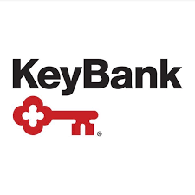
2. What was the case about (Summary of the Case)?
KeyBank National Association and its fraudulent involvement using PPP loans during the COVID-19 pandemic
Tommy Hawkins, a branch manager, facilitated the submission of these loans for small businesses to keep paying employees and cover basic expenses
Loans issued under the CARES Act of 2020 (forgivable loans)
Hawkins submitted ~48 fraudulent applications with false employee numbers and expenses
“The Paycheck Protection Program was designed to support small businesses during the pandemic, not to enrich insiders”
SBA paid nearly $6 million
KeyBank detected suspicious patterns but still submitted forgiveness applications
Result: violation of the False Claims Act, $7.77M settlement, Hawkins sentenced to 65 months
U.S. Attorney’s Office, District of New Jersey. “Key Bank Agrees to Pay $7.7 Million to Resolve Branch Manager’s Fraud.” U.S. Department of Justice, January 7, 2026. justice.gov.

Slide 4
3. Who was (were) the individual(s) and company (ies) involved?
The primary company involved was KeyBank, a U.S. financial services company headquartered in Cleveland, Ohio
The main individual involved was Tommy Hawkins, former branch manager of KeyBank in Conshohocken, Pennsylvania
Additional individuals created or used companies with little or no operations to apply for PPP loans and provide false information
Some of these individuals faced charges and pleaded guilty for fraud and money laundering
“Tommy Hawkins was a bank manager… Hawkins helped… submit PPP loan applications that contained materially false representations.”
The U.S. government, including the Department of Justice (DOJ) and the Small Business Administration (SBA), played a key role in the investigation and enforcement¹
U.S. Attorney’s Office, District of New Jersey. “Key Bank Agrees to Pay $7.7 Million to Resolve Branch Manager’s Fraud.” U.S. Department of Justice, January 7, 2026. justice.gov

Slide 5
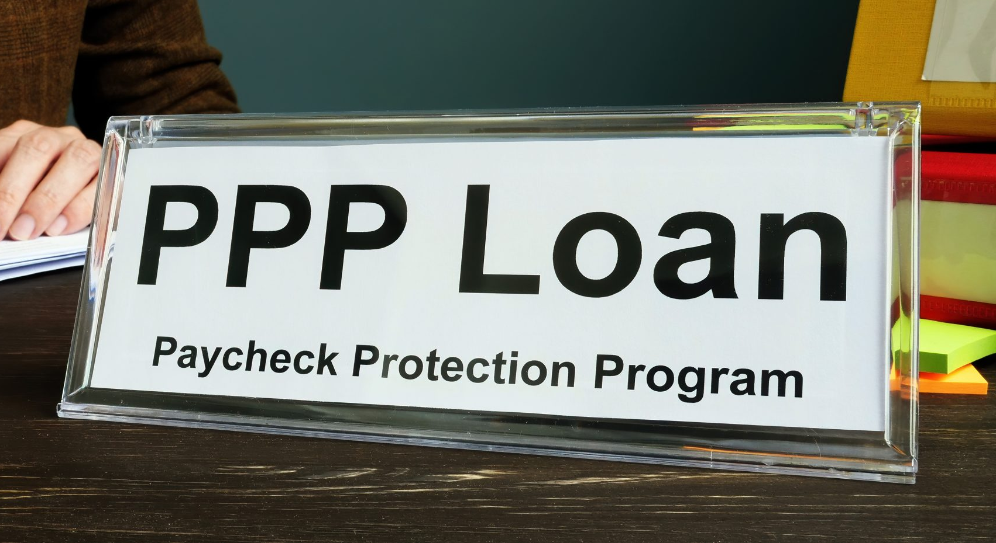
4. a. When did the case begin?
Fraudulent activity happened in 2020 during the pandemic
Hawkins started recruiting people for non-legitimate PPP loans
b. Where did it happen?
Conshohocken Branch of KeyBank
Legal case handled by the U.S. Attorney’s Office, District of New Jersey
c. How much money was involved?
Nearly $6 million fraudulently obtained from the SBA
$7.77 million paid by KeyBank to settle the case

Slide 6
4.d. What period did the violation cover?
2020 to early 2021
Hawkins facilitated fraudulent loan applications
e. When did the case end?
Civil settlement announced in January 2026
Some criminal sentencings still pending
f. What was the amount of the fine paid or criminal sentencing conviction?
Fine paid by KeyBank: $7.77 million
Criminal sentencing conviction: Tommy Hawkins was sentenced to 65 months in prison

Slide 7
5. Why did it happen?
Weak internal controls and individual dishonesty
The branch manager took advantage of the PPP system for personal benefit
Fraudulent loan applications were intentionally submitted
Red flags were not addressed by KeyBank
The bank continued submitting forgiveness applications despite suspicious activity
Oversight, compliance, and risk management flaws
“The fraud resulted from both individual misconduct and institutional failure.”
The urgency of the PPP program led to quicker processing and less verification
This increased the possibility of fraud
U.S. Attorney’s Office, District of New Jersey. “Key Bank Agrees to Pay $7.7 Million to Resolve Branch Manager’s Fraud.” U.S. Department of Justice, January 7, 2026. justice.gov

Slide 8
6. How did it come to the attention of the media?
KeyBank noticed suspicious transactions in the origination of PPP loans
The bank conducted an internal investigation and reported it to the SBA
This led to additional scrutiny by federal authorities, including the DOJ
The case became public through media coverage and official press releases
U.S. Attorney’s Office, District of New Jersey. “Key Bank Agrees to Pay $7.7 Million to Resolve Branch Manager’s Fraud.” U.S. Department of Justice, January 7, 2026. justice.gov

Slide 9
7. What was the outcome of the case?
“The case resulted in both civil and criminal consequences:”
Civil penalty: $7.7M settlement (KeyBank)
Criminal penalty: 65-month prison sentence (Hawkins)
Additional individuals charged or pleaded guilty
U.S. Attorney’s Office, District of New Jersey. “Key Bank Agrees to Pay $7.7 Million to Resolve Branch Manager’s Fraud.” U.S. Department of Justice, January 7, 2026.

Slide 10
8. How could this case have been avoided?
Individual level
Tommy Hawkins and his co conspirators should have acted ethically and complied with legal regulations
Institutional level
The bank should have implemented stricter internal controls
More effective verification processes could have prevented the fraud
Red flags should have been addressed immediately
Suspicious loan applications should not have been processed or forgiven

Slide 11
9. What can we learn from the case?
Acting ethical and following proper procedures is essential
Identifying fraud without addressing it at its root is not enough
Financial institutions must take corrective action when red flags are detected
Strong internal controls and supervision are necessary to prevent further harm
Failure to act can lead to financial losses and legal consequences
Upholding public trust is crucial, especially when managing government-backed funds
Ethical responsibility requires fast and decisive action

Slide 12
Bibliography
U.S. Department of Justice. (2026). KeyBank Agrees to Pay $7.7 Million to Resolve Branch Manager’s Fraud. January 7, 2026. https://www.justice.gov
U.S. Small Business Administration. (2020). Paycheck Protection Program. https://www.sba.gov
CFA Institute. Code of Ethics and Standards of Professional Conduct. https://www.cfainstitute.org

